Slide 1
Week 2
Alexey V. Zimin
JHU BME 580.417/707

Slide 2
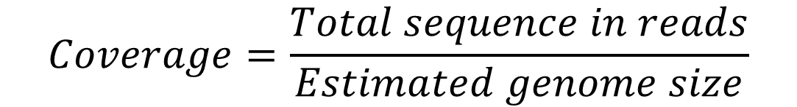
Coverage
Coverage refers to redundancy in sequencing data
Commonly expressed as <number>x, such as 20x, 30x, etc.
For paired reads one can compute coverage by reads and coverage by fragments
$$Coverage=\frac{Total sequence in reads}{Estimated genome size}$$
fragment or insert
read
AGATAGACATAGACATAGACAGATACACTCGATCG
TCTATCTGTATCTGTATCTGTCTATGTGAGCTAGC
read

Slide 3
How much coverage is sufficient?
It depends… on read lengths
1x is enough if read length == chromosome length
In general read length << chromosome length
Problem: assume fixed read length << chromosome length
  What is the probability of a gap?
  Use Poisson distribution!

Slide 4
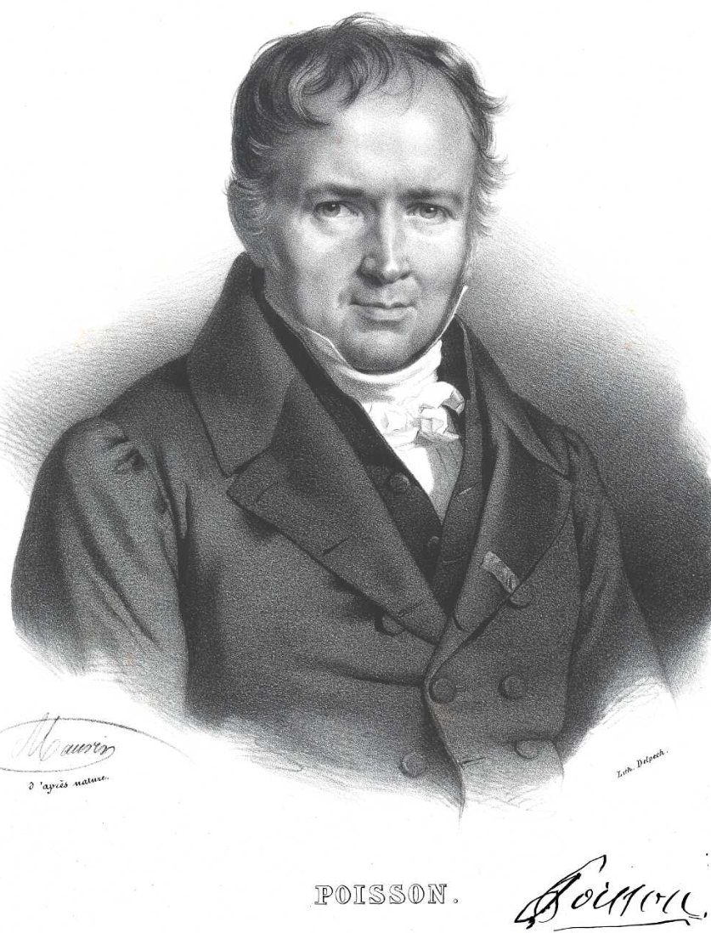
Poisson distribution
The Poisson distribution is a discrete probability distribution that expresses the probability of a given number of events occurring in a fixed interval of time if these events occur with a known constant mean rate and independently of the time since the last event.
Named after French mathematician Siméon Denis Poisson (1781–1840). Image credit:Wikipedia

Slide 5
Example of a Poisson process
For instance, consider a call center which receives an average of λ = 3 calls per minute at all times of day.
If the number of calls received in any two given disjoint time intervals is independent, then the number k of calls received during any minute has a Poisson probability distribution.
Can you come up with an example?

Slide 6
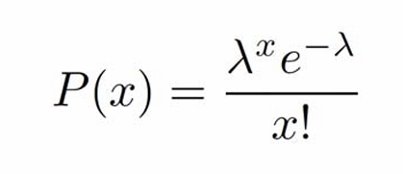
Poisson distribution
The Poisson distribution is also the limit of a binomial distribution, for which the probability of success for each trial p equals λ/n, as the number of trials n approaches infinity
Under a Poisson distribution with the expectation of λ events in a given interval, the probability of x events in the same interval is:

Slide 7
Poisson distribution and coverage
Let:
  G genome length (in bp)
  L read average length (L<<G)
  N number of reads
Then:
  λ, sequencing redundancy = N*L/G
  x is the number of reads covering a given site on the genome
For a given base on the genome for each read Prob(base covered)=L/G << 1; number of attempts (reads): N >> 1.
Genome coverage λ = NL/G is O(1).
x=2 x=4 x=0

Slide 8
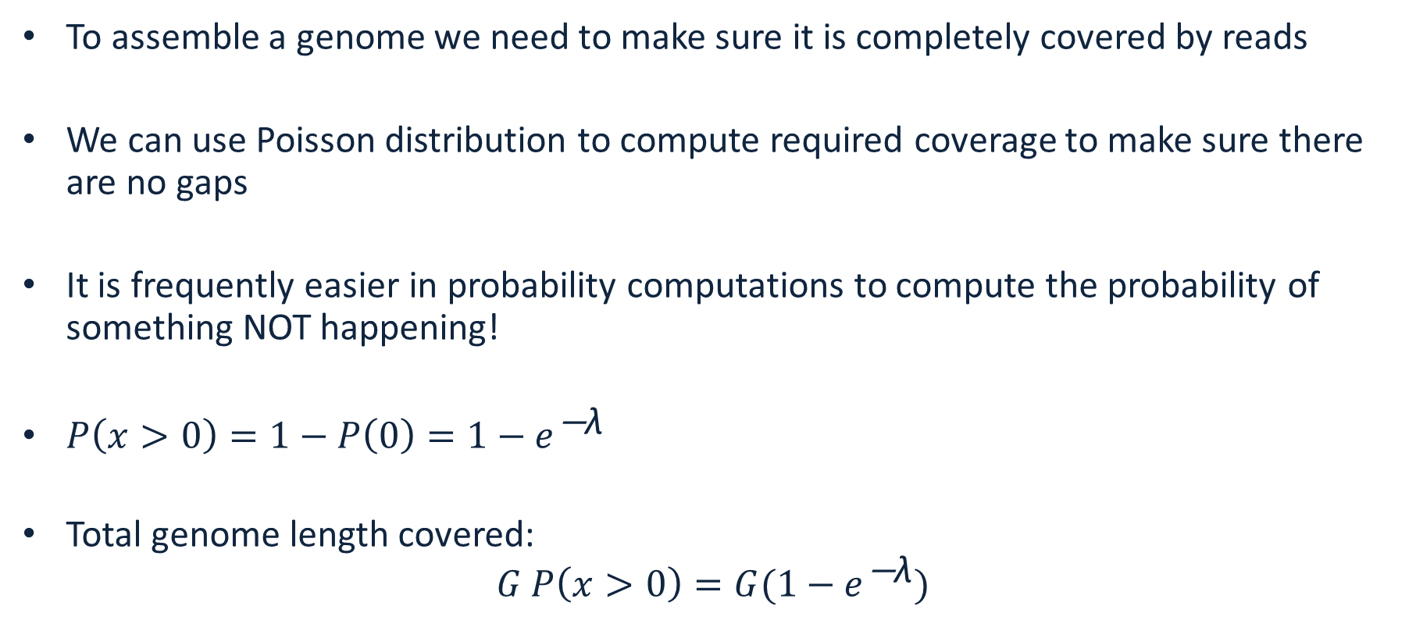
Fraction of the genome covered
To assemble a genome we need to make sure it is completely covered by reads
We can use Poisson distribution to compute required coverage to make sure there are no gaps
It is frequently easier in probability computations to compute the probability of something NOT happening!
${P\left(x>0\right)=1−P\left(0\right)=1−e}^{\text{−}\text{λ}}$
Total genome length covered:
${G P\left(x>0\right)=G(1−e}^{\text{−}\text{λ}})$

Slide 9
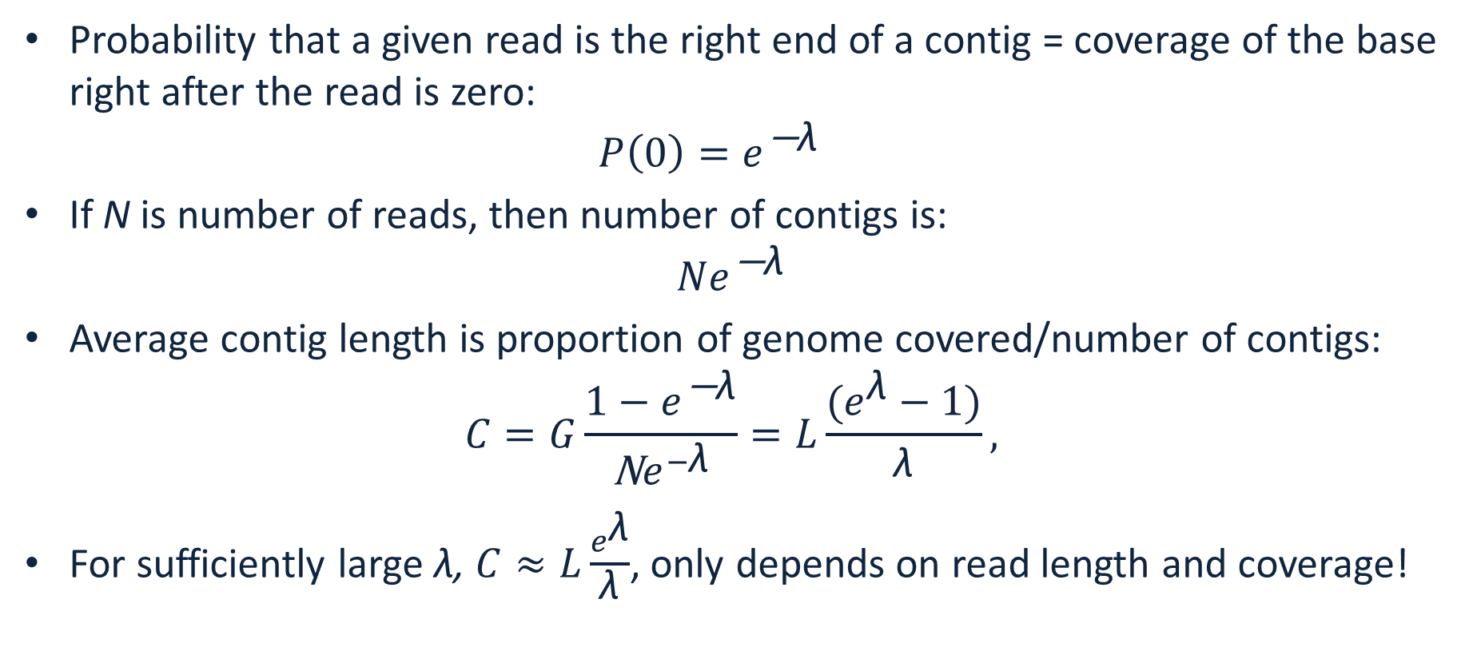
Number of contigs and average length
Probability that a given read is the right end of a contig = coverage of the base right after the read is zero:
${P\left(0\right)=e}^{\text{−}\text{λ}}$
If N is number of reads, then number of contigs is:
${Ne}^{\text{−}\text{λ}}$
Average contig length is proportion of genome covered/number of contigs:
$C=G\frac{{1−e}^{\text{−}\text{λ}}}{\text{N}e^{−\text{λ}}}=L\frac{(e^{\text{λ}}−1)}{\text{λ}},$
For sufficiently large λ, $C≈L\frac{e^{\text{λ}}}{\text{λ}}$, only depends on read length and coverage!

Slide 10
Genome is fully covered.
Can this be assembled?
1 bp overlap
0 bp overlap
1 bp overlap

Slide 11
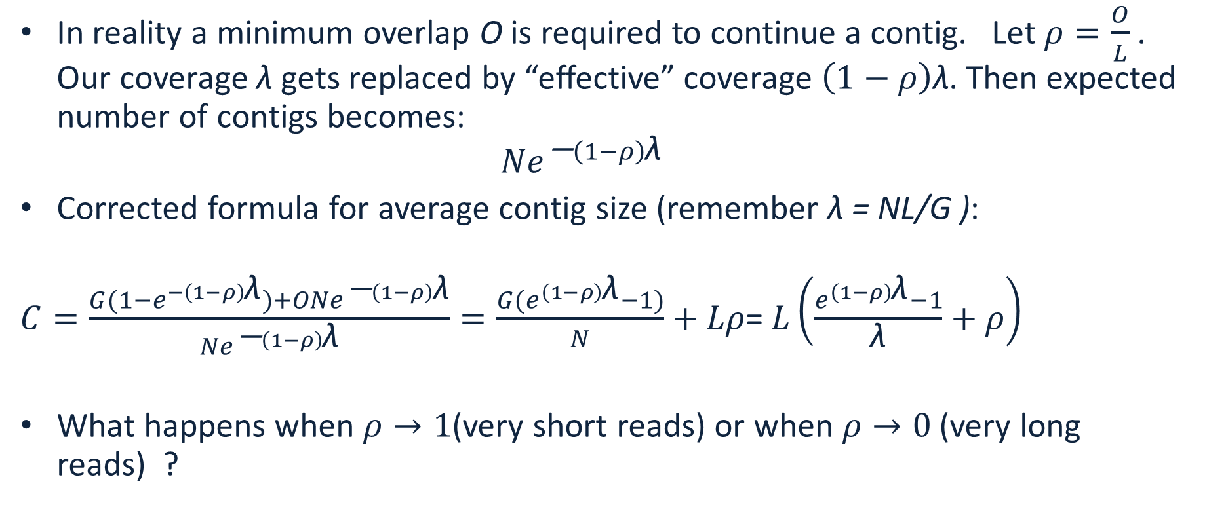
Real life correction to contig length
In reality a minimum overlap O is required to continue a contig. Let $ρ=\frac{O}{L}$. Our coverage $\text{λ}$gets replaced by “effective” coverage $\left(1−ρ\right)\text{λ}$. Then expected number of contigs becomes:
${Ne}^{\text{−}\left(1−ρ\right)\text{λ}}$
Corrected formula for average contig size (remember λ = NL/G ):
$C=\frac{{G(1−e}^{−\left(1−ρ\right)\text{λ}})+O{Ne}^{\text{−}\left(1−ρ\right)\text{λ}}}{{Ne}^{\text{−}\left(1−ρ\right)\text{λ}}}=\frac{{G(e}^{\left(1−ρ\right)\text{λ}}−1)}{N}+Lρ$= $L\left(\frac{e^{\left(1−ρ\right)\text{λ}}−1}{\text{λ}}+ρ\right)$
What happens when $ρ→1$(very short reads) or when $ρ→0$ (very long reads) ?

Slide 12
Reads are Strings
String S is a finite sequence of characters from an alphabet
DNA alphabet is {A,C,G,T}
Substring of S is a string occurring inside S:
AGTGACATAAGACT
Prefix of S is a string starting at the beginning of S:
AGTGACATAAGACT
Suffix of a string is a string ending at the end of S:
AGTGACATAAGACT

Slide 13
Exact matching
Find exact matches of two strings:
T: ATGATATGACATAGAC and P: ATGAC
Naïve: check every position:
T:ATGATATGACATAGAC
P:ATGAC
Boyer-Moore bad character rule, skip pointless alignments:
  consider the character in T at which the comparison process failed (assuming such a failure occurred).
  Find the next occurrence of that character to the left in P
  Propose a shift which brings that occurrence in line with the mismatched occurrence in T.
  If the mismatched character does not occur to the left in P, a shift is proposed that moves the entirety of P past the point of mismatch.

Slide 14
Exact matching
Boyer-Moore bad character rule, skip pointless alignments:
T:ATGATATGACATAGAC
P:ATGAC
check last character – if no match skip to the first occurrence, aligning the T
T:ATGATATGACATAGAC
P:ATGAC
P:ATGAC
P:ATGAC
P:ATGAC
P:ATGAC
P:ATGAC
P:ATGAC

Slide 15
What is an alignment (overlap)?
An alignment does not need to be an exact match
Given:
  – a pair of strings
  – a method for scoring a candidate alignment
Do:
  – determine the correspondences between substrings in
  the sequences such that the similarity score is maximized

Slide 16
Example of an alignment (overlap)
Alignment of two DNA sequences
AGCGAACGCTGAACGCTAGACCG
and
GCGATCGATGAAGCTAGACTCGT
is
AGCGAACGCTGAACGCTAGAC-CG
|||| || ||||*|||||||*||
GCGATCGATGAA-GCTAGACTCGT

Slide 17
Types of mis-matches
Substitutions: AAGT vs ATGT
Deletions: AAGT vs ATT
Insertions: AAGT vs AAGCT

Slide 18

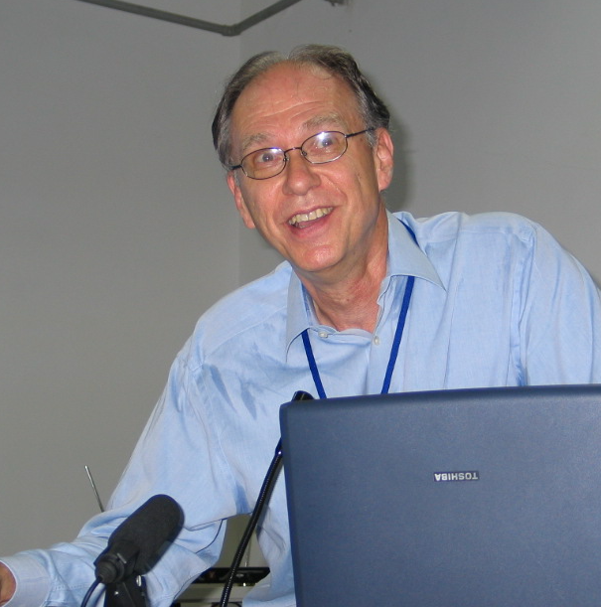
Smith-Waterman alignment
Temple Smith
Proposed by Michael S. Waterman and Temple F. Smith in 1981
Local sequence alignment
Fairly expensive: for sequences of lengths m and n is of order O(m²n+n²m), later optimized by Gotoh and Altschul to O(mn)
Dynamic programming: solve many local problems to then solve the big problem
Michael Waterman
Images from Wikipedia

Slide 19
Smith-Waterman alignment
Align sequences:
TGTTACGG and
GGTTGACTA
Choose match score (substitution matrix)
s(a,b)=3 if a=b,
s(a,b)=-3 if a!=b
 |  | T | G | T | T | A | C | G | G
 | 0 | 0 | 0 | 0 | 0 | 0 | 0 | 0 | 0
G | 0
G | 0
T | 0
T | 0
G | 0
A | 0
C | 0
T | 0
A | 0
 | A | C | G | T
A | 3 | -3 | -3 | -3
C | -3 | 3 | -3 | -3
G | -3 | -3 | 3 | -3
T | -3 | -3 | -3 | 3

Slide 20
Smith-Waterman alignment
Align sequences:
TGTTACGG and
GGTTGACTA
Choose match score (substitution matrix)
s(a,b)=3 if a=b,
s(a,b)=-3 if a!=b
Choose gap penalty G=2
Initialize top row and the first column with zeros
 |  | T | G | T | T | A | C | G | G
 | 0 | 0 | 0 | 0 | 0 | 0 | 0 | 0 | 0
G | 0
G | 0
T | 0
T | 0
G | 0
A | 0
C | 0
T | 0
A | 0

Slide 21
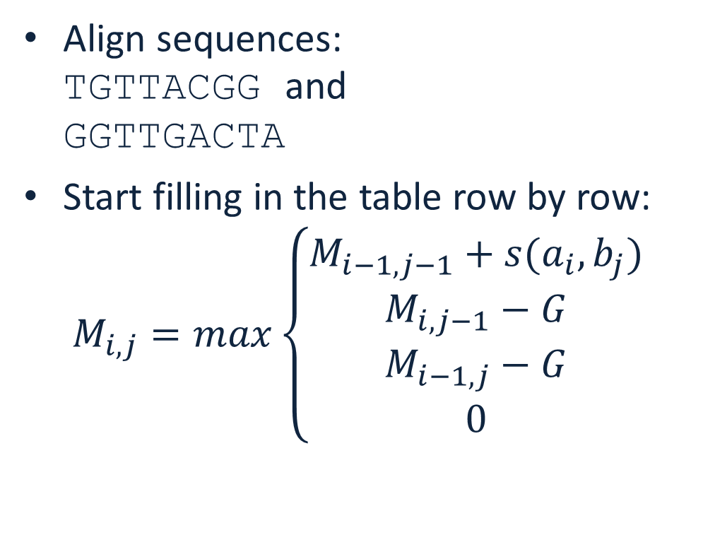
Smith-Waterman alignment
Align sequences:
TGTTACGG and
GGTTGACTA
Start filling in the table row by row:
$M_{i,j}=max\left\{\begin{matrix}M_{i−1,j−1}+s(a_{i},b_{j}) \\ M_{i,j−1}−G \\ \begin{matrix}M_{i−1,j}−G \\ 0\end{matrix}\end{matrix}\right.$
 |  | T | G | T | T | A | C | G | G
 | 0 | 0 | 0 | 0 | 0 | 0 | 0 | 0 | 0
G | 0
G | 0
T | 0
T | 0
G | 0
A | 0
C | 0
T | 0
A | 0

Slide 22
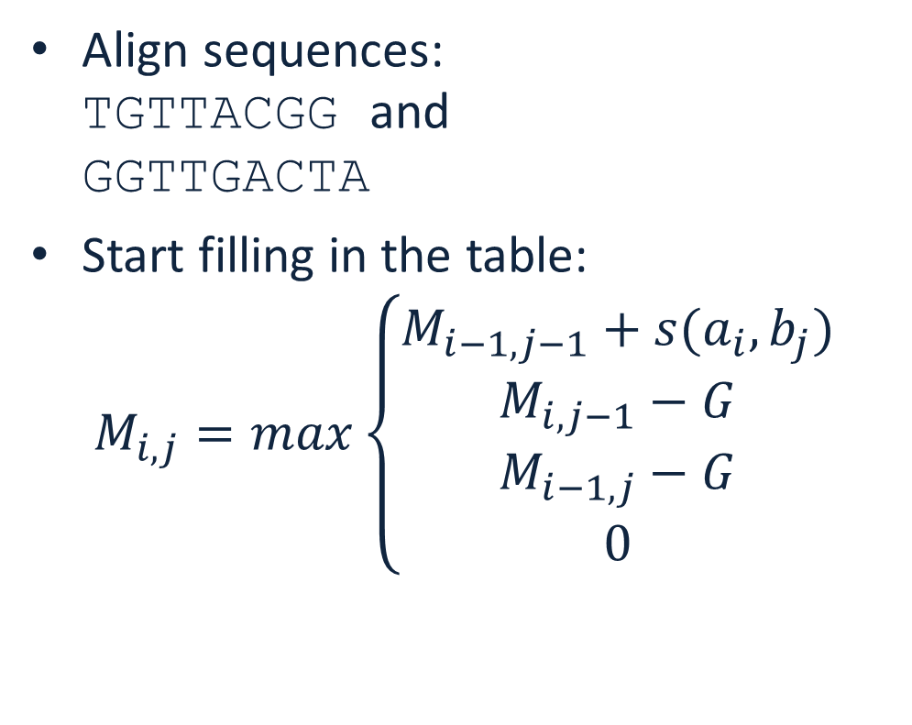
Smith-Waterman alignment
Align sequences:
TGTTACGG and
GGTTGACTA
Start filling in the table:
$M_{i,j}=max\left\{\begin{matrix}M_{i−1,j−1}+s(a_{i},b_{j}) \\ M_{i,j−1}−G \\ \begin{matrix}M_{i−1,j}−G \\ 0\end{matrix}\end{matrix}\right.$
 |  | T | G | T | T | A | C | G | G
 | 0 | 0 | 0 | 0 | 0 | 0 | 0 | 0 | 0
G | 0 | 0 | 3 | 1 | 0 | 0 | 0 | 3 | 3
G | 0
T | 0
T | 0
G | 0
A | 0
C | 0
T | 0
A | 0

Slide 23
Smith-Waterman alignment
Align sequences:
TGTTACGG and
GGTTGACTA
Start filling in the table:
$M_{i,j}=max\left\{\begin{matrix}M_{i−1,j−1}+s(a_{i},b_{j}) \\ M_{i,j−1}−G \\ \begin{matrix}M_{i−1,j}−G \\ 0\end{matrix}\end{matrix}\right.$
 |  | T | G | T | T | A | C | G | G
 | 0 | 0 | 0 | 0 | 0 | 0 | 0 | 0 | 0
G | 0 | 0 | 3 | 1 | 0 | 0 | 0 | 3 | 3
G | 0 | 0 | 3 | 1 | 0 | 0 | 0 | 3 | 6
T | 0
T | 0
G | 0
A | 0
C | 0
T | 0
A | 0

Slide 24
Smith-Waterman alignment
Align sequences:
TGTTACGG and
GGTTGACTA
Start filling in the table:
$M_{i,j}=max\left\{\begin{matrix}M_{i−1,j−1}+s(a_{i},b_{j}) \\ M_{i,j−1}−G \\ \begin{matrix}M_{i−1,j}−G \\ 0\end{matrix}\end{matrix}\right.$
 |  | T | G | T | T | A | C | G | G
 | 0 | 0 | 0 | 0 | 0 | 0 | 0 | 0 | 0
G | 0 | 0 | 3 | 1 | 0 | 0 | 0 | 3 | 3
G | 0 | 0 | 3 | 1 | 0 | 0 | 0 | 3 | 6
T | 0 | 3 | 1 | 6 | 4 | 2 | 0 | 1 | 4
T | 0
G | 0
A | 0
C | 0
T | 0
A | 0

Slide 25
Smith-Waterman alignment
Align sequences:
TGTTACGG and
GGTTGACTA
Start filling in the table:
$M_{i,j}=max\left\{\begin{matrix}M_{i−1,j−1}+s(a_{i},b_{j}) \\ M_{i,j−1}−G \\ \begin{matrix}M_{i−1,j}−G \\ 0\end{matrix}\end{matrix}\right.$
 |  | T | G | T | T | A | C | G | G
 | 0 | 0 | 0 | 0 | 0 | 0 | 0 | 0 | 0
G | 0 | 0 | 3 | 1 | 0 | 0 | 0 | 3 | 3
G | 0 | 0 | 3 | 1 | 0 | 0 | 0 | 3 | 6
T | 0 | 3 | 1 | 6 | 4 | 2 | 0 | 1 | 4
T | 0 | 3 | 1 | 4 | 9 | 7 | 5 | 3 | 2
G | 0 | 1 | 6 | 4 | 7 | 6 | 4 | 8 | 6
A | 0 | 0 | 4 | 3 | 5 | 10 | 8 | 6 | 5
C | 0 | 0 | 2 | 1 | 3 | 8 | 13 | 11 | 9
T | 0 | 3 | 1 | 5 | 4 | 6 | 11 | 10 | 8
A | 0 | 1 | 0 | 3 | 2 | 7 | 9 | 8 | 7

Slide 26
Smith-Waterman alignment
Align sequences:
TGTTACGG and
GGTTGACTA
Pick the cell with the highest score
Traceback exploring all return paths of the same score
  at every step choose the highest score
  stop at 0
 |  | T | G | T | T | A | C | G | G
 | 0 | 0 | 0 | 0 | 0 | 0 | 0 | 0 | 0
G | 0 | 0 | 3 | 1 | 0 | 0 | 0 | 3 | 3
G | 0 | 0 | 3 | 1 | 0 | 0 | 0 | 3 | 6
T | 0 | 3 | 1 | 6 | 4 | 2 | 0 | 1 | 4
T | 0 | 3 | 1 | 4 | 9 | 7 | 5 | 3 | 2
G | 0 | 1 | 6 | 4 | 7 | 6 | 4 | 8 | 6
A | 0 | 0 | 4 | 3 | 5 | 10 | 8 | 6 | 5
C | 0 | 0 | 2 | 1 | 3 | 8 | 13 | 11 | 9
T | 0 | 3 | 1 | 5 | 4 | 6 | 11 | 10 | 8
A | 0 | 1 | 0 | 3 | 2 | 7 | 9 | 8 | 7

Slide 27
Smith-Waterman alignment
Align sequences:
TGTTACGG and
GGTTGACTA
Alignment result:
TGTT-ACGG
||| ||
GGTTGACTA
 |  | T | G | T | T | A | C | G | G
 | 0 | 0 | 0 | 0 | 0 | 0 | 0 | 0 | 0
G | 0 | 0 | 3 | 1 | 0 | 0 | 0 | 3 | 3
G | 0 | 0 | 3 | 1 | 0 | 0 | 0 | 3 | 6
T | 0 | 3 | 1 | 6 | 4 | 2 | 0 | 1 | 4
T | 0 | 3 | 1 | 4 | 9 | 7 | 5 | 3 | 2
G | 0 | 1 | 6 | 4 | 7 | 6 | 4 | 8 | 6
A | 0 | 0 | 4 | 3 | 5 | 10 | 8 | 6 | 5
C | 0 | 0 | 2 | 1 | 3 | 8 | 13 | 11 | 9
T | 0 | 3 | 1 | 5 | 4 | 6 | 11 | 10 | 8
A | 0 | 1 | 0 | 3 | 2 | 7 | 9 | 8 | 7

Slide 28
Alignment of two genomes
Consider two genomes, each in many contiguous pieces (contigs), M and N, of average size m and n
Each Smith-Waterman contig-to-contig alignment would include doing O(m*n) operations, and we must do it M*N times, so the total cost is O(M*N*m*n)
A solution is to seed the alignments with short exact matches:
  Maximal Exact Matches (MEMs), based on suffix tree or suffix array
  Minimizers
Then do Smith-Waterman in-between the seeds

Slide 29
K-mers
K-mer is a subsequence of length K of a genomic sequence
A genomic sequence of length L has L-K+1, K-mers
A K-mer is canonical if it comes before its reverse complement in lexicographic order
These two 10-mers are the same, the canonical one is in the red
GCTAGAGACT
AGTCTCTAGC

Slide 30
Using K-mers to seed alignments
AGATAGATAGACAACATAGACT
1 AGATAGAAA
7 ATACACAAC
15 CACAGACT

Slide 31
Using K-mers to seed alignments
AGATAGATAGACAACATAGACT
1 AGATA (1,5)
2 GATAG
ATAGA (7,15)
TAGAT
AGATA (1,5)
GATAG
ATAGA (3,16)
TAGAC (17)
AGACA
GACAA
ACAAC
CAACA
AACAT
ACATA
CATAG
ATAGA (7,3)
TAGAC (8)
AGACT
AGATAGAAA
ATACACAAC
CACAGACT

Slide 32
Using K-mers to seed alignments
AGATAGATAGACAACATAGACT
AGATA (1,5)
GATAG (2)
ATAGA (3,7,16)
TAGAT (4)
GATAG (6)
TAGAC (8,17)
AGACA (9)
GACAA (10)
ACAAC (11)
CAACA (12)
AACAT (13)
ACATA (14)
CATAG (15)
AGACT (18)
AGATAGAAA
ATACACAAC
CACAGACT

Slide 33
Using K-mers to seed alignments
AGATAGATAGACAACATAGACT
AGATA (1,5)
GATAG (2)
ATAGA (3,7,16)
TAGAT (4)
GATAG (6)
TAGAC (8,17)
AGACA (9)
GACAA (10)
ACAAC (11)
CAACA (12)
AACAT (13)
ACATA (14)
CATAG (15)
AGACT (18)
AGATAGAAA
Implied position:
1,1,5
CACAGACT
ATACACAAC

Slide 34
Using K-mers to seed alignments
AGATAGATAGACAACATAGACT
AGATA (1,5)
GATAG (2)
ATAGA (3,7,16)
TAGAT (4)
GATAG (6)
TAGAC (8,17)
AGACA (9)
GACAA (10)
ACAAC (11)
CAACA (12)
AACAT (13)
ACATA (14)
CATAG (15)
AGACT (18)
AGATAGAAA
Implied positions:
1,1,5
CACAGACT
Implied positions:
15
ATACACAAC
Implied positions:
7

Slide 35
Method of minimizers
Using all K-mers is expensive!!!
You can think of reducing the number (use every other one?)
An effective way to use fewer K-mer alignment seeds is method of minimizers
Smaller memory footprint and much faster for large data sets (e.g. computing overlaps between reads, or mapping the reads to a genome)
Does not require computing an index
Less sensitive

Slide 36
Numerical value of a K-mer
A K-mer uniquely corresponds to an integer:
  A=0
  C=1
  G=2
  T=3
Use base 4: AGT=0+2*4+3*16
Equivalent to Minimum Perfect Hash
K-mers ⬄ integers
def kmer2int(kmer):
nt_map = {'A': 0, 'C': 1, 'G': 2, 'T': 3}
val = 0
pow=1
for i, nt in enumerate(kmer):
val += nt_map[nt] * pow
pow=pow*4
return val
# Example usage
kmer = "ACGT"
print(f"The numerical of '{kmer}' is: {kmer2int(kmer)}")

Slide 37
Minimizers
Minimizers are a subset of K-mers from a string, with the guarantee that similar set of K-mers will be chosen on similar strings.
Parameterized by:
  K-mer length k
  window length w
  ordering of k-mers (by numerical value or lexicographical)
Can minimize numerical value or lexicographic value
Make sure to use canonical k-mers or take minimum value of k-mer and its reverse complement!!!

Slide 38
Example of minimizers
Consider genomic string:
GCCCATGACTCGCATGCTGACATGCTGCTAGCT
Let k=10, w=5
Minimize numerical values
The first 5 K-mers:
GCCCATGACT = 863318
CCCATGACTC = 477973
CCATGACTCG = 643781
CATGACTCGCA = 423089
ATGACTCGCAT = 3251500

Slide 39
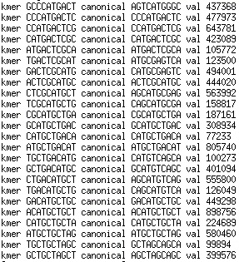
Example of minimizers
Consider genomic string: GCCCATGACTCGCATGCTGACATGCTGCTAGCT
Let k=10, w=5
minimizer

Slide 40
Example of minimizers
Consider genomic string: GCCCATGACTCGCATGCTGACATGCTGCTAGCT
Let k=10, w=5
minimizer

Slide 41
Example of minimizers
Consider genomic string: GCCCATGACTCGCATGCTGACATGCTGCTAGCT
Let k=10, w=5
minimizer

Slide 42
Example of minimizers
Consider genomic string: GCCCATGACTCGCATGCTGACATGCTGCTAGCT
Let k=10, w=5
minimizer

Slide 43
Example of minimizers
Consider genomic string: GCCCATGACTCGCATGCTGACATGCTGCTAGCT
Let k=10, w=5
minimizer

Slide 44
Example of minimizers
Consider genomic string: GCCCATGACTCGCATGCTGACATGCTGCTAGCT
Let k=10, w=5
minimizer
minimizer

Slide 45
Example of minimizers
Consider genomic string: GCCCATGACTCGCATGCTGACATGCTGCTAGCT
Let k=10, w=5
minimizer
minimizer
minimizer

Slide 46
Example of minimizers
Consider genomic string: GCCCATGACTCGCATGCTGACATGCTGCTAGCT
Let k=10, w=5
minimizer
minimizer
minimizer

Slide 47
Example of minimizers
Consider genomic string: GCCCATGACTCGCATGCTGACATGCTGCTAGCT
Let k=10, w=5
minimizer
minimizer
minimizer
minimizer

Slide 48
Example of minimizers
Consider genomic string: GCCCATGACTCGCATGCTGACATGCTGCTAGCT
Let k=10, w=5
minimizer
minimizer
minimizer
minimizer
minimizer
minimizer
minimizer

Slide 49
Seeding alignments with minimizers
Consider genomic strings: GCCCATGACTCGCATGCTGACATGCTGCTAGCT
ACCCATGACTCGCA-GATGACATGCTGCTAGAT

Slide 50
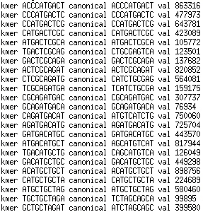
Seeding alignments with minimizers
Consider genomic strings: GCCCATGACTCGCATGCTGACATGCTGCTAGCT
ACCCATGACTCGCA-GATGACATGCTGCTAGAT
minimizer
minimizer
minimizer
minimizer
minimizer
minimizer
minimizer
minimizer
minimizer
minimizer
minimizer
minimizer
minimizer

Slide 51
Seeding alignments with minimizers
Consider genomic strings: GCCCATGACTCGCATGCTGACATGCTGCTAGCT
ACCCATGACTCGCA-GATGACATGCTGCTAGAT
minimizer
minimizer
minimizer
minimizer
minimizer
minimizer
minimizer
minimizer
minimizer
minimizer
minimizer
minimizer
minimizer

Slide 52
Seeding alignments with minimizers
Alignment:
GCCCATGACTCGCATGCTGACATGCTGCTAGCT
||||||||||||| | |||||||||||||| |
ACCCATGACTCGCA-GATGACATGCTGCTAGAT
You can do Smith-Waterman in-between the exact matches!

Slide 53
Seeding alignments with minimizers
Alignment:
GCCCATGACTCGCATGCTGACATGCTGCTAGCT
||||||||||||| | |||||||||||||| |
ACCCATGACTCGCA-GATGACATGCTGCTAGAT
You can do Smith-Waterman in-between the exact matches!

Slide 54
Using minimizers to compute candidate alignments
Read R1 minimizers M1 at O1, M2 at O2 M3 at O3
Read R2 minimizers M4 at O4, M1 at O5 M2 at O6
Read R3 minimizers M3 at O7, M5 at O8
Build MRO file:
  M1 R1 O1
  M2 R1 O2
  M3 R1 O3
  M4 R2 O4
  M1 R2 O5
  M2 R2 O6
  M3 R3 O7
  M5 R3 O8
  M1 R1 O1
  M1 R2 O5
  M2 R1 O2
  M2 R2 O6
  M3 R1 O3
  M3 R3 O7
  M4 R2 O4
  M5 R3 O8
  M1 R1 O1, R2 O5
  M2 R1 O2, R2 O6
  M3 R1 O3, R3 O7
  M4 R2 O4
  M5 R3 O8
Sort by minimizer
Collect reads
Check alignments

